Slide 1
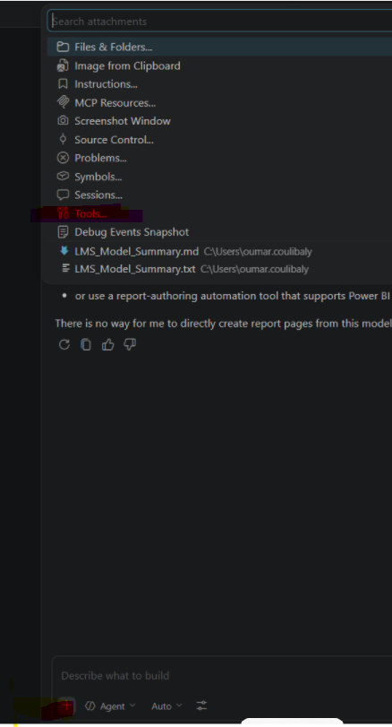
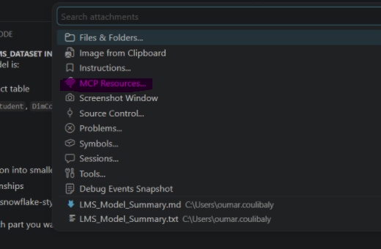
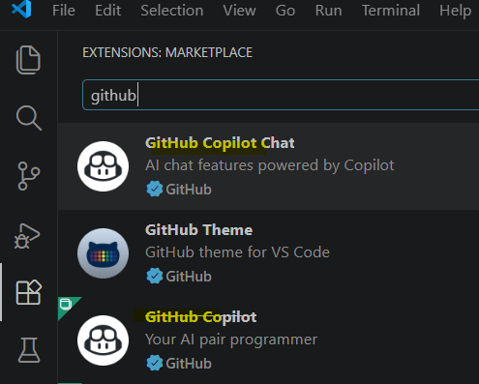
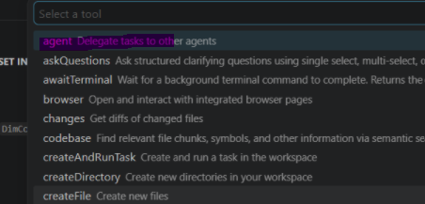
Power bi mcp server
Verify the settings and make sure the
Pbi mcp server is installed
Install the following 3 apps :
VS code (from google)
Github copilot (from vs extention)
Github copilot chat (from vs extention)
Make sure you selected Agent

